Slide 1
Software Requirement Engineering Software Engineering Department Spring 2025
Muhammad Huzaifa Shah

Slide 2
Types of Software Requirements
Functional requirements
Non-functional requirements
Domain requirements
Inverse requirements
Design and implementation constraints

Slide 3
Non-Functional Requirements - 1
Most non-functional requirements relate to the system as a whole.
They include constraints on:
Timing
Performance
Reliability
Security
Maintainability
Accuracy
Development process and
Standards, etc.

Slide 4
Non-Functional Requirements - 2
For example, if an aircraft system does not meet reliability requirements, it will not be certified as ‘safe’
If a real-time control system fails to meet its performance requirements, the control functions will not operate correctly

Slide 5
Non-Functional Requirements
Most non-functional requirements relate to the system as a whole. They include constraints on timing, performance, reliability, security, maintainability, accuracy, the development process, standards, etc.
They are often more critical than individual functional requirements.
Capture the emergent behavior of the system, that is they relate to system as a whole.
Why?

Slide 6
Non-Functional Requirements (cont..)
Must be built into the framework of the software product
Failure to meet a non-functional system requirement may make the whole system unusable
1. For example, if an aircraft system does not meet reliability requirements, it will not be certified as ‘safe’
2. If a real-time control system fails to meet its performance requirements, the control functions will not operate correctly

Slide 7
Non-Functional Requirements (cont..)
Non-functional requirements arise through user needs
because of budget constraints
because of organizational policies
because of the need of interoperability with other software and hardware systems or
because of external factors such as safety regulations, privacy legislation, etc.

Slide 8
Non-Functional Requirements (cont..)
Non-Functional
Requirements
1. Product
Requirements
2. Organizational
Requirements
3. External
Requirements

Slide 9
1. Product Requirements Examples
The system shall allow one hundred thousand hits per minute on the website
The system shall not have down time of more than one second for continuous execution of one thousand hours

Slide 10
1. Product Requirements
Product
Requirements
Usability
Requirements
Efficiency
Requirements
Reliability
Requirements
Portability
Requirements
Performance
Requirements
Space
Requirements

Slide 11
2. Organizational Requirements
Organizational
Requirements
Standards
Requirements
Implementation
Requirements
Delivery
Requirements

Slide 12
2. Organizational Requirements Examples
The system development process and deliverable documents shall conform to the ISO 9000
(International Organization for Standardization)
Any development work sub-contracted by the development organization shall be carried out in accordance with Capability Maturity Model (CMM a framework that helps organizations improve their processes and performance over time)
Notes:
ISO 9000 is defined as a set of international standards on quality management and quality assurance developed to help companies effectively document the quality system elements needed to maintain an efficient quality system. They are not specific to any one industry and can be applied to organizations of any size.

Slide 13
3. External Requirements
External
Requirements
Interoperability
Requirements
Ethical
Requirements
Legislative
Requirements
Privacy
Requirements
Safety
Requirements

Slide 14
3. External Requirements Examples
The system shall not disclose any personal information about members of the library system to other members except system administrators
The system shall comply with the local and national laws regarding the use of software tools

Slide 15
Observations on Non-Functional Requirements (1/4)
Non-functional requirements can be written to reflect general goals for the system.
Examples include:
Ease of use
Recovery from failure
Rapid user response

Slide 16
Observations on Non-Functional Requirements (2/4)
Goals are open to misinterpretation
Objective verification is difficult
Distinction between functional and non-functional is not always very clear
Non-functional requirements should be written in a quantitative manner as much as possible, which is not always easy for customers
For some goals, there are no quantitative measures, e.g., maintainability

Slide 17
Observations on Non-Functional Requirements (3/4)
Goals can be useful to designers and developers, as they give clues to them about priorities of the customers
Chances of conflicts within non-functional requirements are fairly high, because information is coming from different stakeholders.
For example, different stakeholders can give different response times or failure tolerance levels, etc.

Slide 18
Observations on Non-Functional Requirements (4/4)
Some negotiations must be done among different stakeholders, to achieve an agreement in these situations
Non-functional requirements should be highlighted in the requirements document, so that they can be used to build the architecture of the software product

Slide 19
NFRs as Goals
Non-functional requirements are sometimes written as general goals, which are difficult to verify
They should be expressed quantitatively using metrics (measures) that can be objectively tested

Slide 20
Example: Goal converted into an NFR
Goal (unverifiable)
“The system should be easy to use by experienced controllers and should be organized in such a way that user errors are minimized”
Non-functional requirement (verifiable)
“Experienced controllers shall be able to use all the system functions after a total of two hours’ training. After this training, the average number of errors made by experienced users shall not exceed two per day”

Slide 21
Metrics for Non-Functional Requirements (NFRs)

Slide 22
Metrics for NFRs - 1
Property | Measure
Speed/Performance | Processed transactions/second Response time Screen refresh time

Slide 23
Metrics for NFRs - 2
Property | Measure
Size | K bytes Number of function points

Slide 24
Metrics for NFRs - 3
Property | Measure
Ease of use | Training time Number of help frames

Slide 25
Metrics for NFRs - 4
Property | Measure
Reliability | Mean time to failure Probability of unavailability Rate of failure occurrence Availability

Slide 26
Metrics for NFRs - 5
Property | Measure
Robustness | Time to restart after failure Percentage of events causing failure Probability of data corruption on failure

Slide 27
Metrics for NFRs - 6
Property | Measure
Portability | Percentage of target-dependent statements Number of target systems

Slide 28
Importance of Metrics used for NFRs
With the help of measures (metrics) the NFRs can be verified quantitatively
It should also be noted that the cost of quantitatively verifying each NFR may be very high

Slide 29
Week Agenda
Software Ethics
Kinds of Software Requirements (Functional & Non-Functional)
Additional Types of Software Requirements
User & Customer Perspectives on Requirements
Common Requirement Issues

Slide 30
Types of Software Requirements
Functional requirements
Non-functional requirements
Domain requirements
Inverse requirements
Design and implementation constraints

Slide 31
Domain Requirements - 1
Requirements that come from the application domain and reflect fundamental characteristics of that application domain
These can be both the functional or non-functional requirements
Domain experts find it difficult to convey domain requirements
Their absence can cause significant dissatisfaction

Slide 32
Domain Requirements - 2
Domain requirements can impose strict constraints on solutions. This is particularly true for scientific and engineering domains
Domain-specific terminology can also cause confusion

Slide 33
Domain Requirements - 3
Example:
In a commission-based sales businesses, there is no concept of negative commission. However, if care is not taken; novice (inexperienced) developers can be lured into developing systems, which calculate negative commission

Slide 34
Domain Requirements - 4
Banking domain has its own specific constraints
Example
Most banks do not allow over-draw on most accounts, however, most banks allow some accounts to be over-drawn

Slide 35
Types of Software Requirements
Functional requirements
Non-functional requirements
Domain requirements
Inverse requirements
Design and implementation constraints

Slide 36
Inverse Requirements - 1
They explain what the system shall not do.
Many people find it convenient to describe their needs in this manner
These requirements indicate the indecisive nature of customers about certain aspects of a new software product

Slide 37
Inverse Requirements - 2
Example:
The system shall not use red color in the user interface, whenever it is asking for inputs from the end-user

Slide 38
Types of Software Requirements
Functional requirements
Non-functional requirements
Domain requirements
Inverse requirements
Design and implementation constraints

Slide 39
Design and Implementation Constraints - 1
These are development guidelines within which the designer must work
These requirements can seriously limit design and implementation options
Can also have impact on human resources

Slide 40
Design and Implementation Constraints - Examples
The system shall be developed using the Microsoft.Net platform
The system shall be developed using open-source tools and shall run on Linux operating system

Slide 41
Examples 1
Domain Requirements: Industry-specific needs (e.g., HIPAA compliance in healthcare)
Inverse Requirements: What the system should not do
Design Requirements: Architectural & design constraints
Implementation Requirements: Programming languages & technologies

Slide 42
Examples 2
Domain: “A financial system must comply with PCI-DSS.”
Inverse: “The system must not allow unauthorized access to personal data.”
Design: “The system should use microservices architecture.”
Implementation: “The backend must be built using Python and Django.”

Slide 43
Week Agenda
Software Ethics
Kinds of Software Requirements (Functional & Non-Functional)
Additional Types of Software Requirements
User & Customer Perspectives on Requirements
Common Requirement Issues

Slide 44
Understanding Stakeholder Perspectives
Users prioritize:
Usability
Performance and
Accessibility
Customers prioritize:
Security
Compliance and
Cost-effectiveness

Slide 45
User & Customer Perspectives on Requirements
Users:
Expect an intuitive and easy-to-use interface
Require fast and efficient system performance
Need accessibility features for diverse users
Customers (Business Owners, Organizations):
Focus on ensuring regulatory compliance (e.g., GDPR, HIPAA)
Prioritize data security and financial constraints
Require cost-efficient and maintainable solutions

Slide 46
Challenges in Meeting Both Perspectives
Balancing usability with security measures
Aligning performance expectations with budget constraints
Ensuring compliance without compromising user experience

Slide 47
Solutions for Aligning Perspectives
Involve both users and customers in requirement gathering
Use iterative design processes (e.g., prototyping and user feedback)
Implement adaptive security and accessibility features

Slide 48
Week Agenda
Software Ethics
Kinds of Software Requirements (Functional & Non-Functional)
Additional Types of Software Requirements
User & Customer Perspectives on Requirements
Common Requirement Issues

Slide 49
Common Requirement Issues
Common Requirement Issues:
Already discussed in Lecture 02 Week 01

Slide 50
The main risks of Requirements Engineering
Insufficient user involvement
Creeping user requirements
Ambiguous requirements
Gold plating
Inaccurate planning
Overlooked user classes

Slide 51
Common Requirement Problems & Solutions
Problem | Solution
Insufficient User Involvement | Engage stakeholders in every phase
Creeping User Requirements | Define and control scope strictly
Ambiguous Requirements | Use clear, measurable language
Gold Plating | Stick to agreed project scope
Inaccurate Planning | Use proper estimation techniques
Overlooked User Classes | Conduct comprehensive user analysis

Slide 52
Best Practices for Contractual and Requirement Management
Clearly define the scope and deliverables in contracts
Establish change control mechanisms
Ensure stakeholder alignment before project initiation
Regular reviews and updates to requirement documents

Slide 53
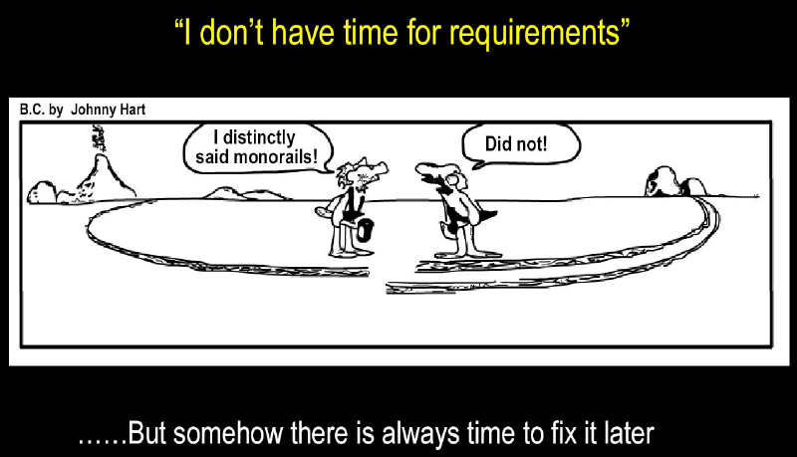
Why Requirements are Important?

